Slide 1

robotics workshop day 1

Slide 2
basics What is a Robot? What does robotics involve? Three laws of robotics Why do we need robots? Most important parts of robots

Slide 3
What is a Robot?
A robot is a machine
It can be programmed
It can do many tasks

Slide 4
Why do we need a robot?
To avoid human intervention

Slide 5
Why do we need a robot?
Dangerous
Boring and/or repetitive
High precision or high speed

Slide 6
Why do we need a robot?
Dangerous
Space
Deep sea
Rescue missions

Slide 7
Why do we need a robot?
Boring and/or repetitive
Welding
part pick and place
manufacturing

Slide 8
Why do we need a robot?
High precision or high speed
Electronics testing
Surgery
precision machining

Slide 9
What does robotics involve?
Robotics = Mechanics
+
Electronics
+
Computer Engineering

Slide 10
How does it work ?
The robot control loop
Sense
Think
Act

Slide 11
How does it work ?
The robot control loop
THINK
Task planning
Plan Classification
Learn
Process data
Path planning
Motion planning
SENSE
Speech, Vision
Acceleration, Temperature
Position ,Distance
Touch, Force
Magnetic field ,Light
Sound ,Position Sense
Sense
Think
Act
ACT
Output information Move, Speech
Text, Visuals Wheels Legs
Arms Tracks

Slide 12
Three laws of robotics
First Law : A robot may not injure a human being, or, through inaction, allow a human being to come to harm, unless this would violate a higher order law
Second Law: A robot must obey orders given it by human beings, except where such orders would conflict with a higher order law
Third Law : A robot must protect its own existence as long as such protection does not conflict with a higher order law.

Slide 13
electronics Current Voltage Resistance

Slide 14
Electronics
Current is the rate at which charge is flowing.

Slide 15
Electronics
Voltage is the difference in charge between two points.

Slide 16
Electronics
Resistance is a material’s tendency to resist the flow of charge (current).

Slide 17
Major circuit elements
Resistor
Capacitor
Inductor
Diode
Transistor

Slide 18
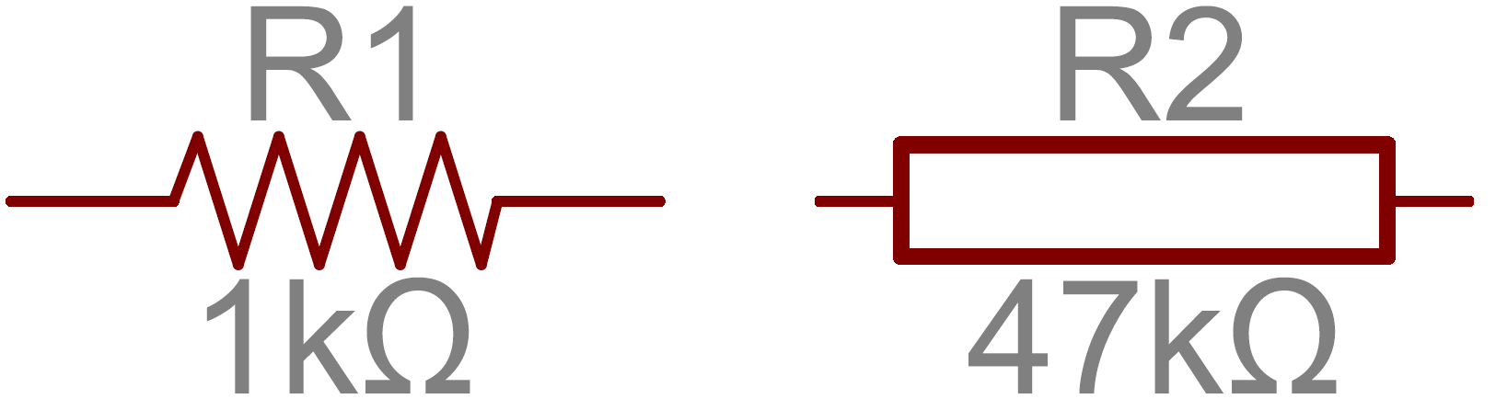
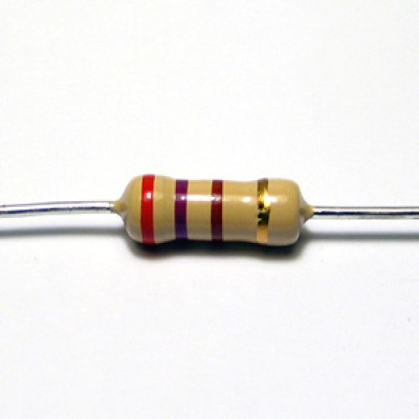
Major circuit elements
Resistor :- The resistor’s resistance limits the flow of electrons through a circuit.
Units : Ohms

Slide 19
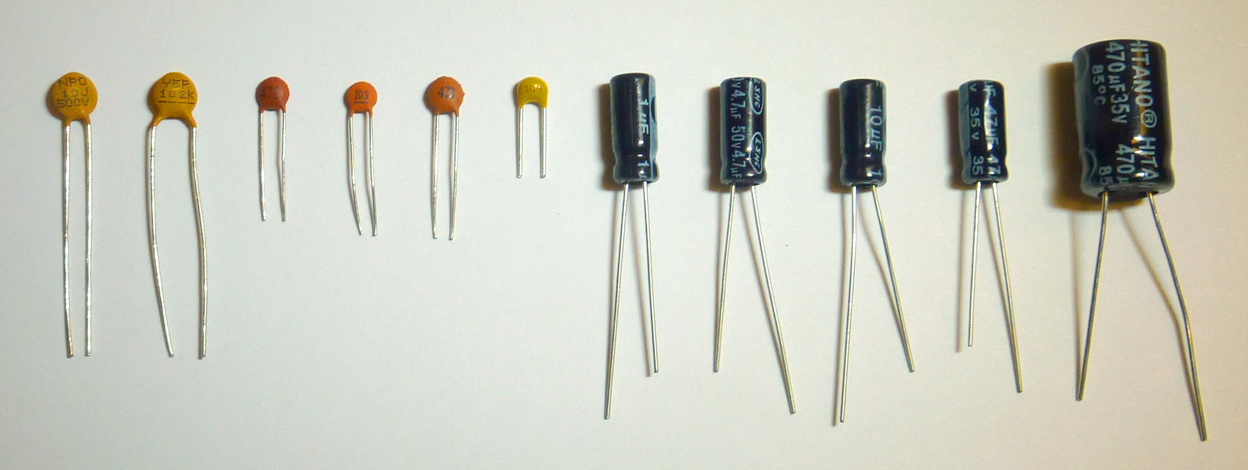
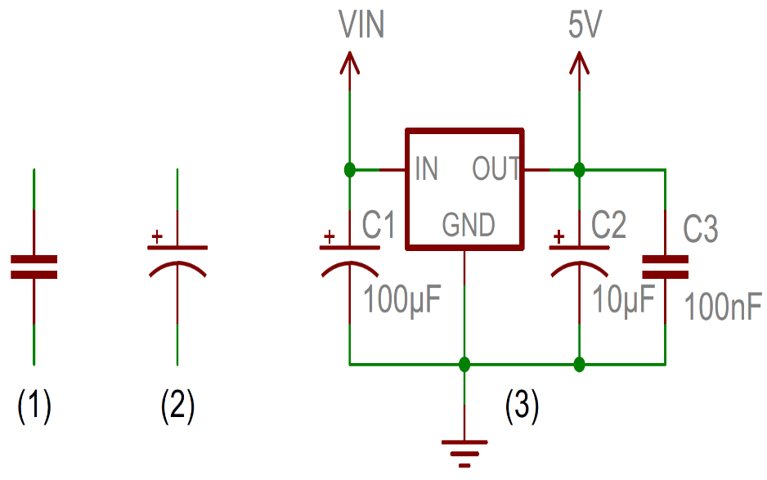
Major circuit elements
Capacitor :- capacitors have a special ability to store energy, they’re like a fully charged electric battery.
Units : Faraday

Slide 20
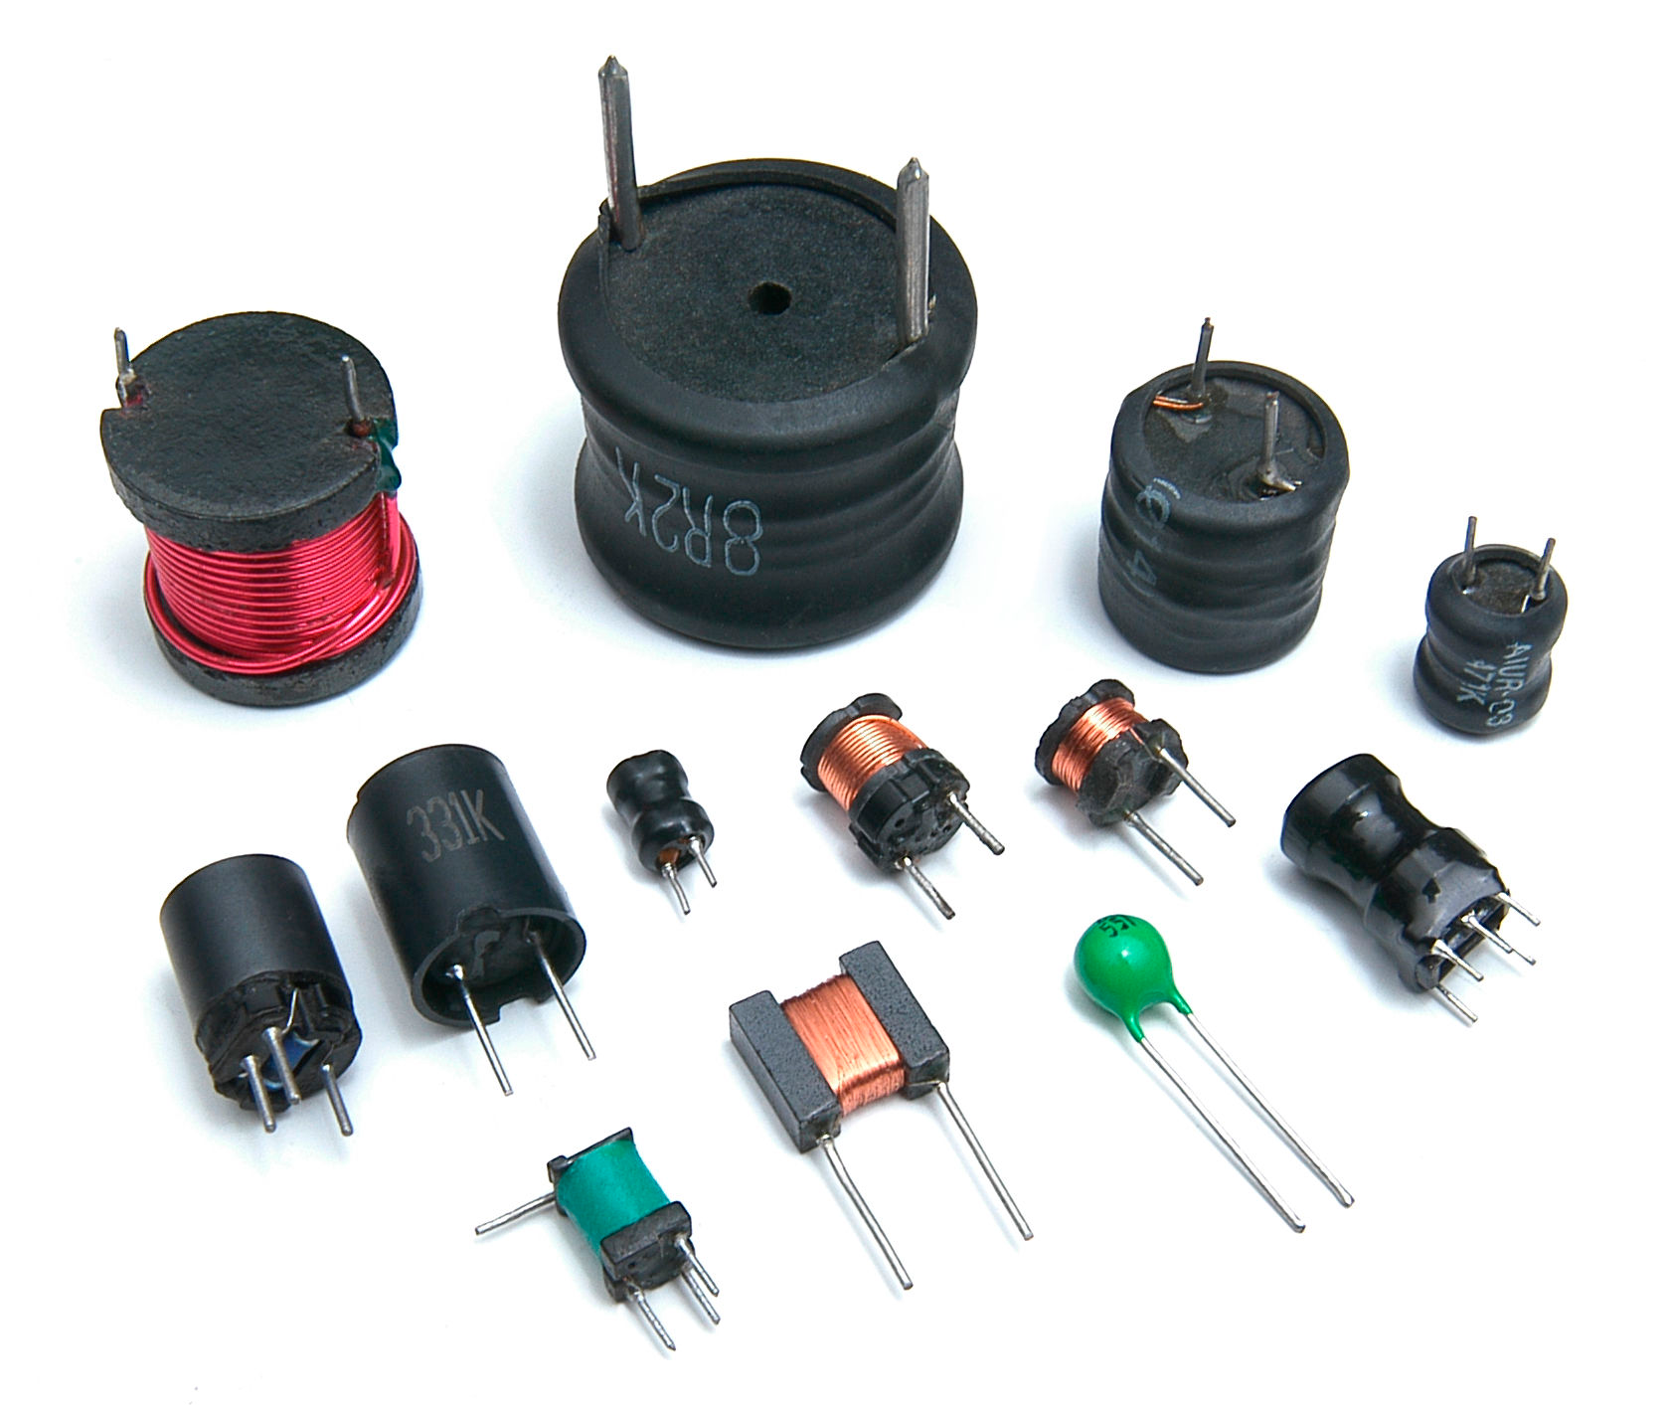
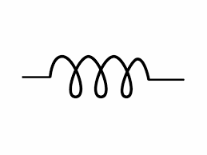
Major circuit elements
Inductor :- An inductor is a passive electronic component that stores energy in the form of a magnetic field.
Units : Henry

Slide 21
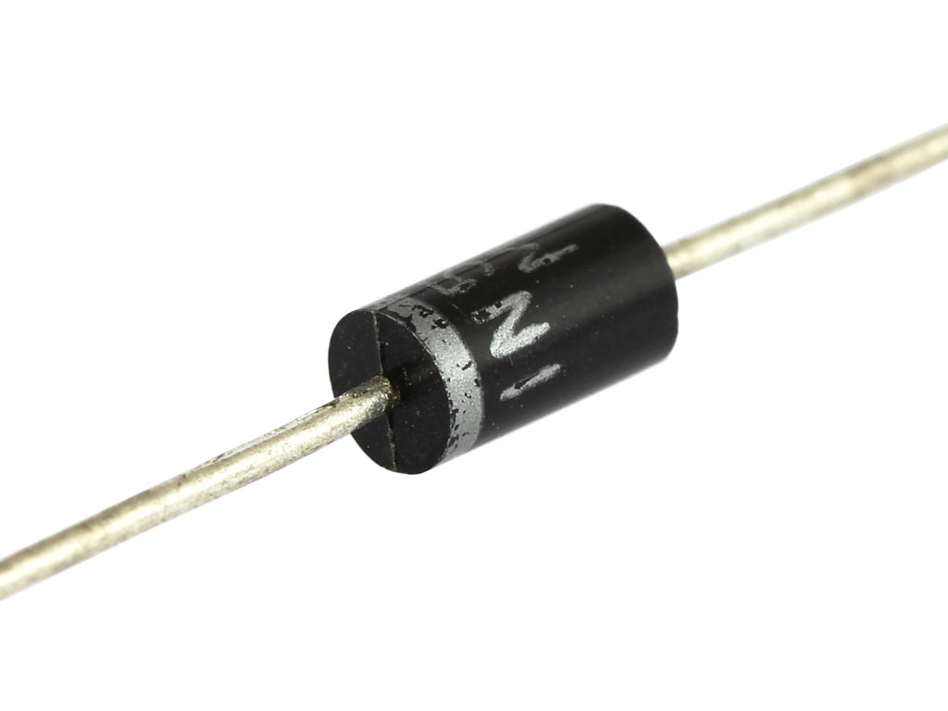
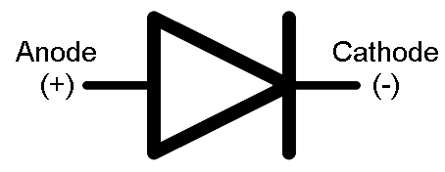
Major circuit elements
Diode :- The key function of an ideal diode is to control the direction of current-flow.

Slide 22
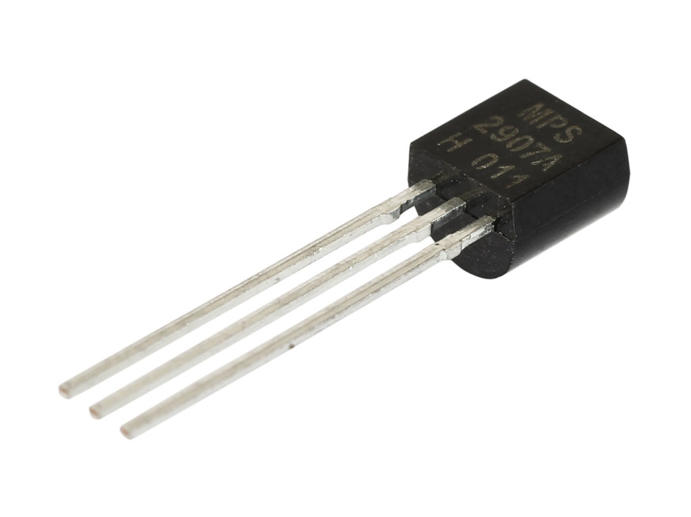
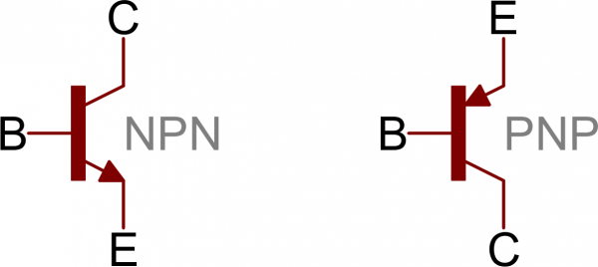
Major circuit elements
Transistor :- A transistor is a semiconductor device used to amplify and switch electronic signals and electrical power.

Slide 23
project 1 dancing lights

Slide 24
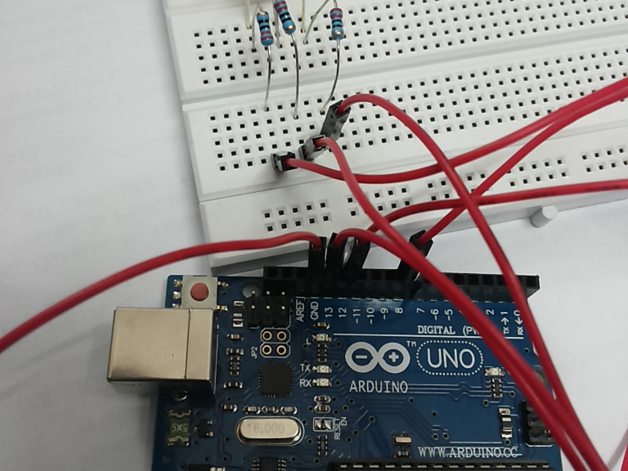
Dancing lights
In this project we make leds switch on and off

Slide 25
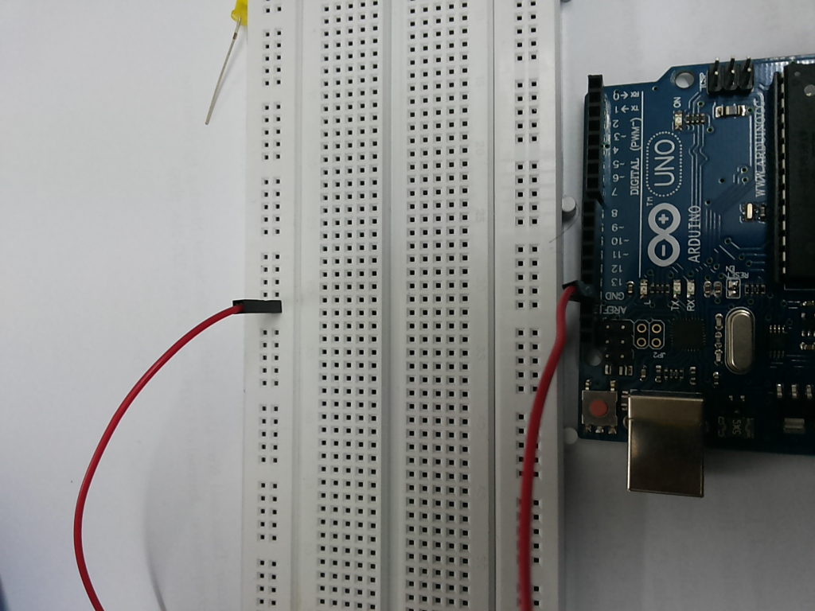
Requirements
Arduino
USB connector
Computer
Bread board
Resistors
LED(red -2 , green – 2 , yellow – 2)
Jumper wires with male to male connectors

Slide 26
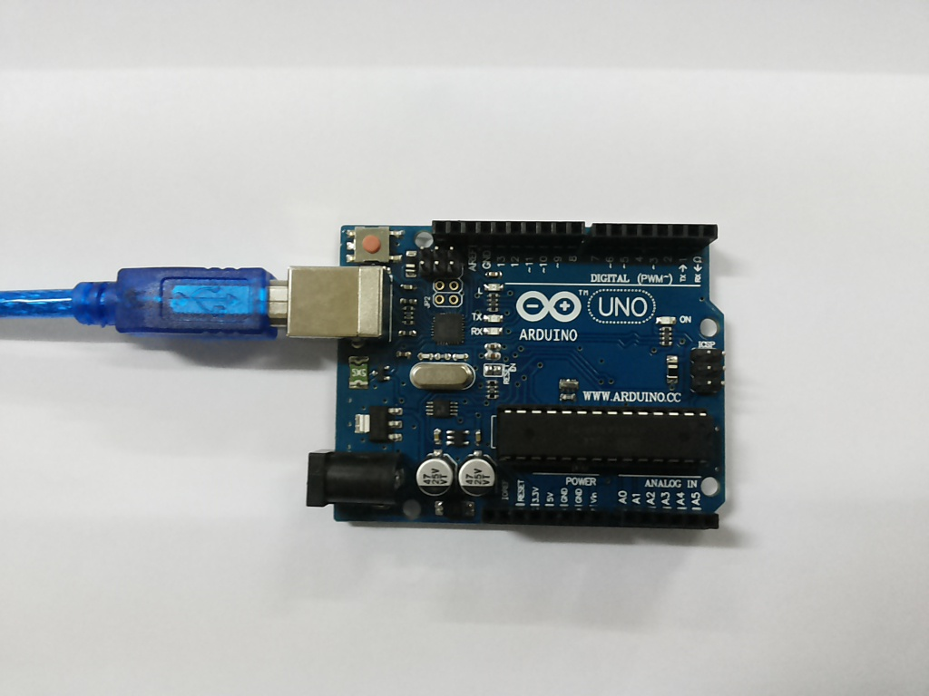
About the parts
Arduino

Slide 27
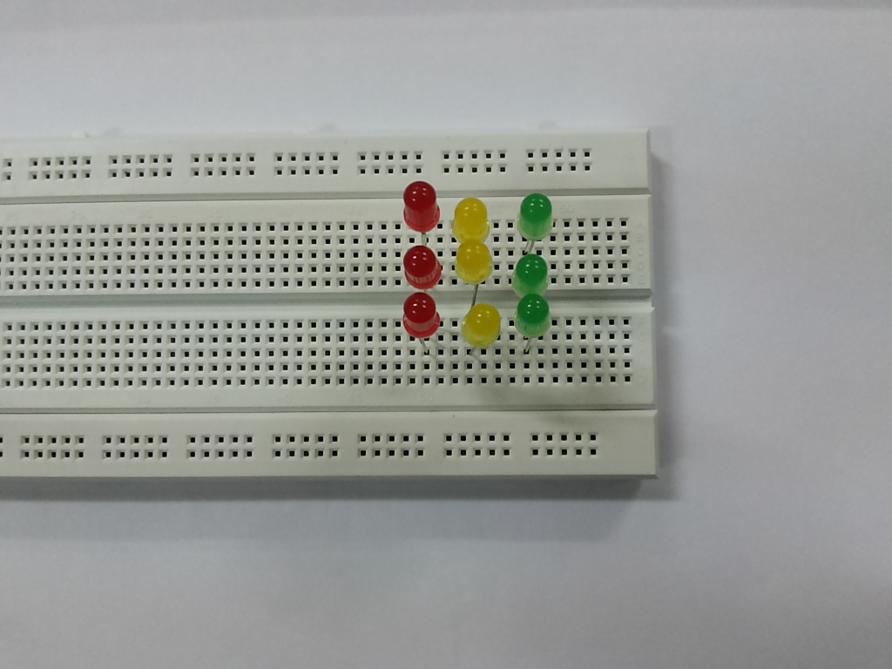
About the parts
Bread board

Slide 28
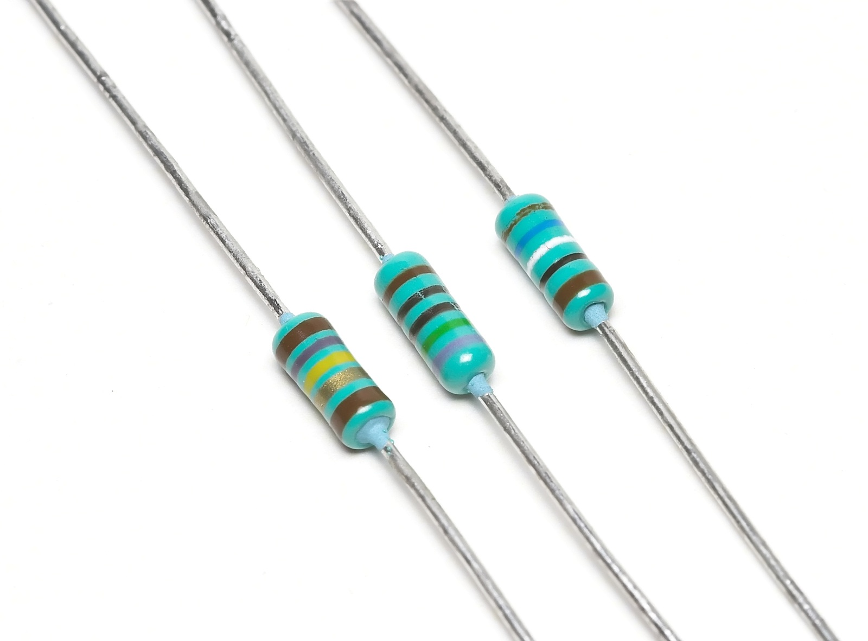
About the parts
Resistors

Slide 29
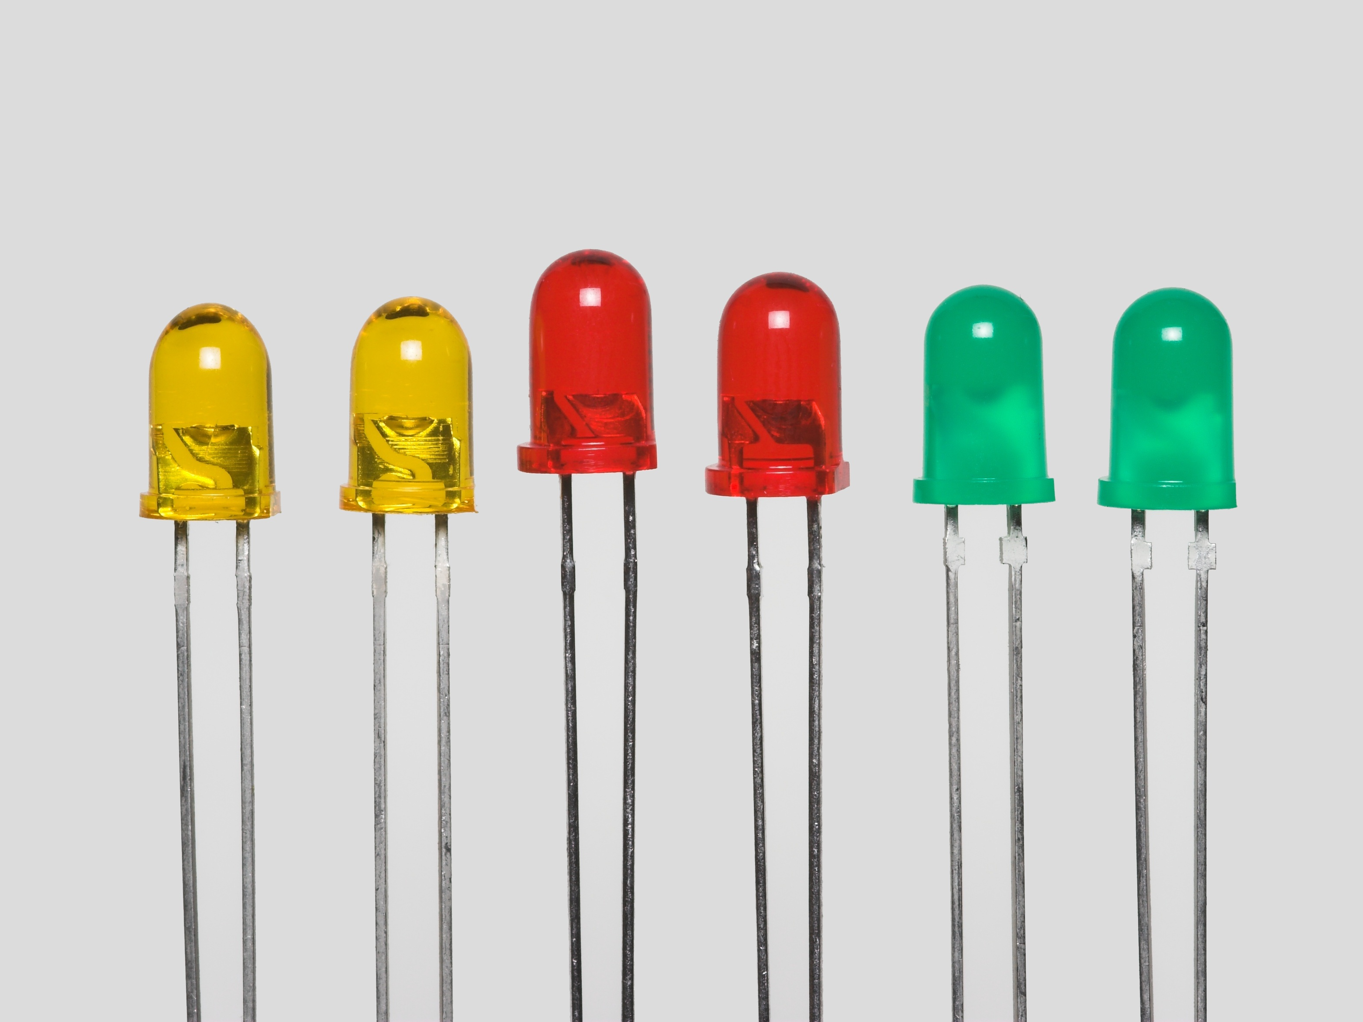
About the parts
LED
Use resistors always

Slide 30
Rules
Do exactly as instructed
Some parts are very fragile and may get damaged if used improperly
Students will have the replace the parts damaged
After the project is over dis-assemble your project very carefully

Slide 31
Steps
Take out the parts you need from the kit box

Slide 32
Steps
Connect your arduino to the system

Slide 33
Steps
Upload the sketch to the arduino
Disconnect after uploading icon is displayed

Slide 34
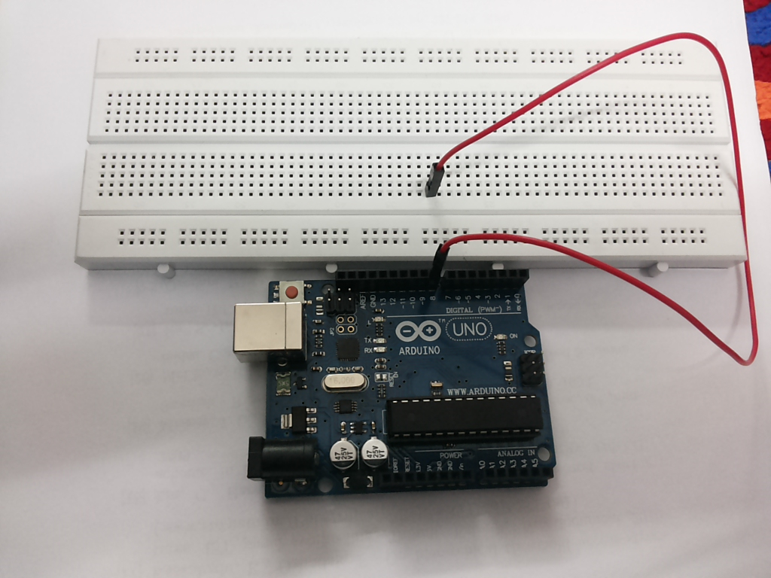
Steps
Connect the jumper wires between arduino and breadboard

Slide 35
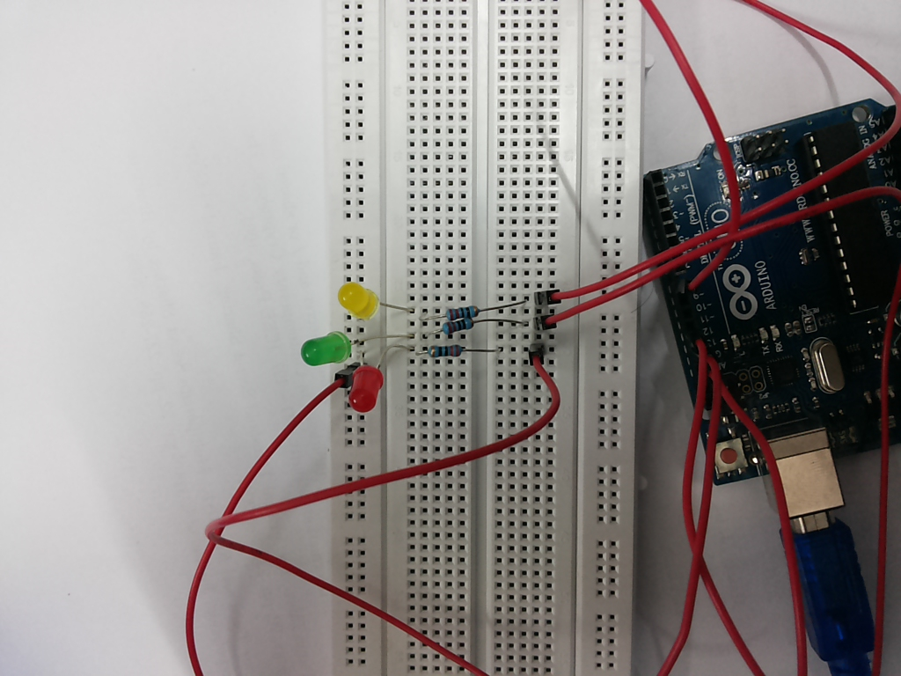
Steps
Take the bread board
Connect the LED’s in this pattern
Connect the resistors as shown

Slide 36
Steps
Connect the battery to the cables

Slide 37
Steps
Connect the pin to Arduino (this will turn on the Arduino)
Your project will now start running

Slide 38
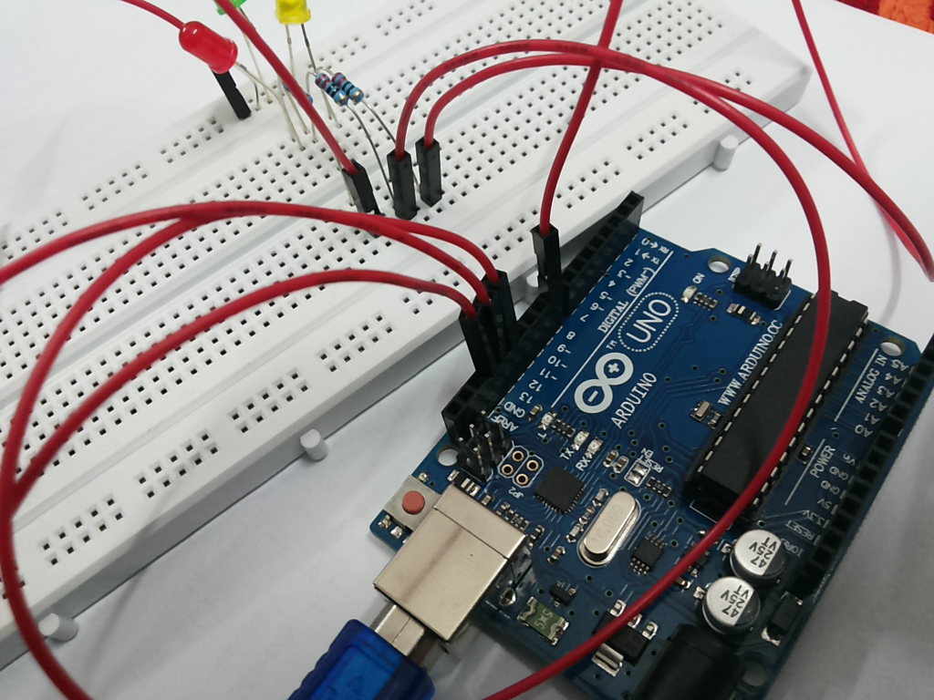
Steps
Congratulations!!
You have built your first project

Slide 39
Summary
What did we do?

Slide 40
Summary
What are the uses of this project?

Slide 41
End
Hope you had fun!
See you tomorrow for the next project: the obstacle avoider

